Slide 1
Smart Air system

Slide 2
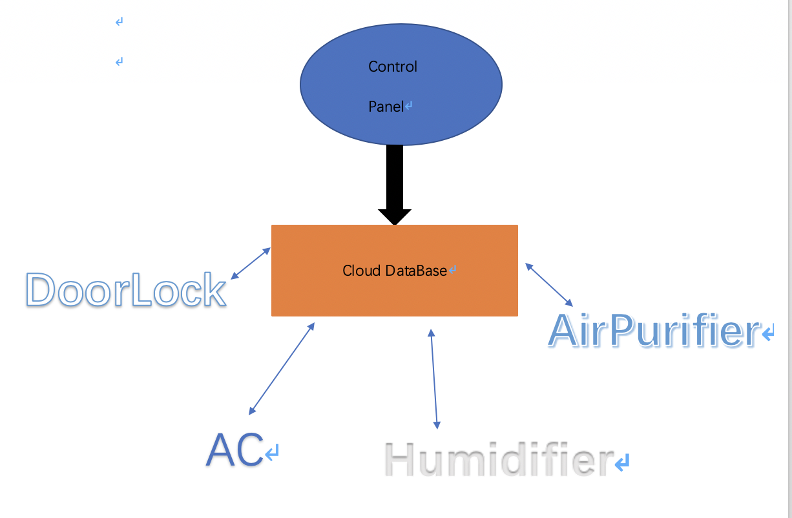

Slide 3
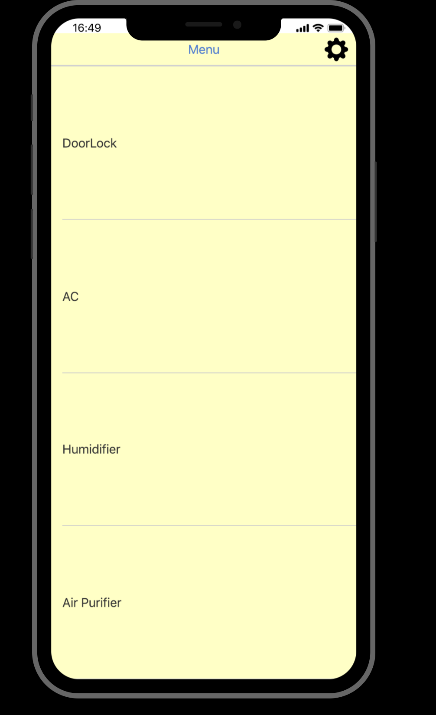
Main menu

Slide 4
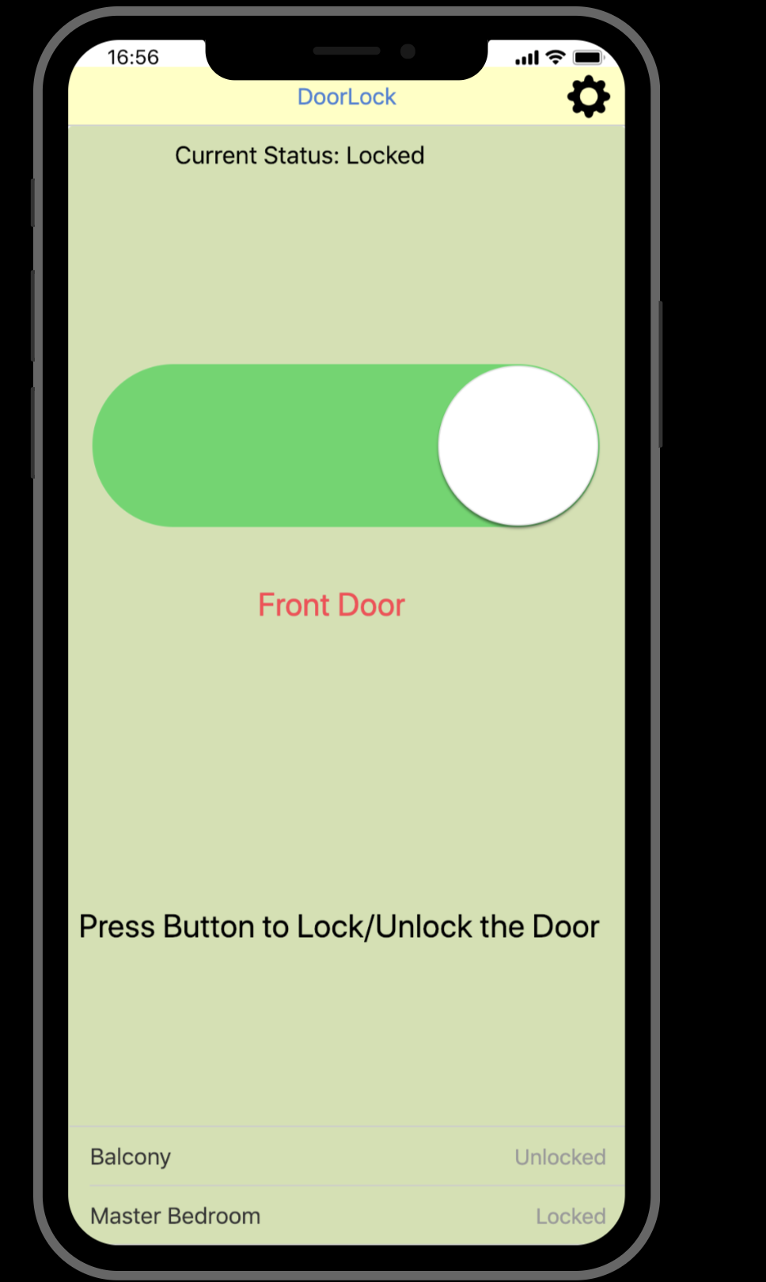
Door Lock
Key Features:
Status
on/off switch
Setting

Slide 5
Thank you
Questions ?

